Slide 1
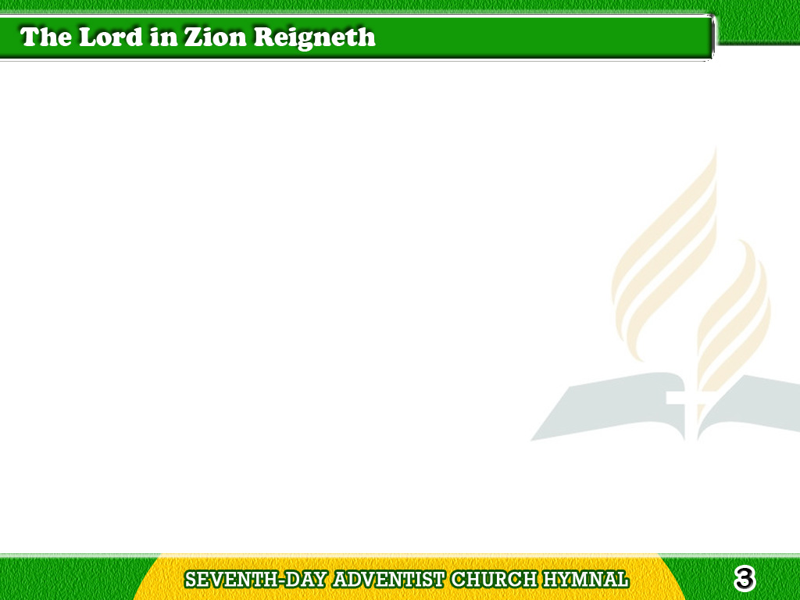
1/3
The Lord in Zion reigneth,
Let all the world rejoice,
And come before
His throne of grace
With tuneful heart and voice;
Tagalog
Version

Slide 2
1/3
The Lord in Zion reigneth,
And there His praise shall ring,
To Him shall princes
bend the knee
And kings their glory bring
Tagalog
Version

Slide 3
2/3
The Lord in Zion reigneth,
And who so great as He?
The depths of earth are in
His hands;
He rules the mighty sea.
Tagalog
Version

Slide 4
2/3
O crown His name with honor,
And let his standard wave
Till distant isles beyond
the deep
Shall own His power to save.
Tagalog
Version

Slide 5
3/3
The Lord in Zion reigneth,
These hours to Him belong;
O enter now His temple gates,
And fill His courts with song;
Tagalog
Version

Slide 6
3/3
Beneath His royal banner
Let every creature fall,
Exalt the King of heaven
and earth,
And crown Him Lord of all.
Tagalog
Version

